Slide 1
Project development under public private partnership (PPP) Models
Presenter : Afzal Dar

Slide 2
Infrastructure project development facility
Inception& Mandate
Unit of GOP
Inception
Launched by Prime Minister in to act as a bridge between public & private sectors by facilitating infrastructure development under PPP methodology
IPDF is the central PPP unit of the GOP, incorporated by MOF to facilitate government departments/agencies in developing their infrastructure projects under PPP methodology
Role of IPDF
Facilitate the preparation of PPP transactions & the promotion, generation & implementation of PPP projects
Sectors
Transport & logistics, Mass Urban public transport, municipal services, social sector, energy, etc.

Slide 3
Infrastructure Project Development Facility (IPDF)
IPDF Mandate
IPDF assists in the transaction structuring as well as implementation
Transaction structuring entails conducting a detailed feasibility, needs & options analysis
and risk assessment study
Transaction implementation, on the other hand, involves the structuring of the
concession agreement on the most suitable Public Private Partnership modality
and the procurement of the private party
IPDF is mandated to develop the following enabling framework:
Policy
Law
Standardized Provisions
Guidelines for Ministries, Departments and Private Sector
Model Concession Agreement
Assistance to Provincial Governments in setting-up PPP cells

Slide 4
PPP: What is it?
PPPs: Introduction
Medium to long term relationship between the public sector and the partners (including voluntary organisations)
Involves sharing and transferring of risks and rewards between public sector and the partners
Attempts to utilise multi-sectoral and multi-disciplinary expertise to structure, finance and deliver desired policy outcomes that are in public interest
Clear governance structures established to manage the partnerships
PPPs: INTRODUCTION

Slide 5
PPP: What is it?
PPPs: Introduction
It is about creating, nurturing and sustaining an effective relationship between the Government and the private sector
Achieving improved value for money by utilising the innovative capabilities and skills to deliver performance improvements and efficiency savings.
It aims to leverage private sector expertise and capital to obtain efficiency gains in service delivery and asset creation.
Life-cycle responsibility, value for money, output specification, risk transfer-4 fundamental but challenging aspects of PPP
PPPs: INTRODUCTION

Slide 6
PPP: What is it?
IPDF Introduction
Designed to maximize the use of Private Sector Skills
Risk placed where it can be managed best
Activities performed by those most capable
Public and Private Sector each retain their own identity
They collaborate on the basis of a clear division of tasks and risks
PPP offers to the Public Sector greater Value for Money:
PPP transaction facilitates technology transfer
Private Sector shares its experience with Public Sector
PPP delivers high quality infrastructure in the shortest possible time
PPPs: INTRODUCTION

Slide 7
Forms of public private partnerships(ppp)
Service Contracts
100 % non-public ownership
Enabler/ Regulator
Divestures
BOO
Concessions
BOT
Governments’ Role
Leases
Management contracts
100 % Public ownership
Provider
Duration
5
10
15
20
25
30
Increasing level of delegation, risk & irreversibility

Slide 8
PPP: various options
PPP Participation vs. Sector Maturity
Key Considerations
Service contracts: Cost-effective way to meet special technical needs, but benefits are limited
Management contracts: useful for rapidly enhancing technical capacity, efficiency, and degree of private sector’s involvement
Leases: An efficient way to pass on commercial risk. Appropriate when large scope for operating efficiency and limited scope for new investments
Concessions: Pass full responsibility for operations and investment to the private sector
Build-operate-transfer (BOT) or variations resemble concessions but are normally used for greenfield projects, such as wastewater treatment plant
Full cost recovery
Divestiture /
BOO
Concession /
BOT
Water Sector Maturity
Lease
Management
Contract
Service
Contract
Low cost recovery
No asset ownership; with operational responsibilities
Responsibility of Private Sector
Asset ownership with operational and commercial responsibility
Notes:
MENA countries should explore different PPP approaches and tailor them to the water sector maturity and local environment
Selecting which scheme to adopt depends on many factors, including the sector maturity in terms of economics, regulation, service delivery efficiency, level of investments required, etc.
It is also important to note that there are many variations to each type of contract and adopting a cookie-cutter approach based on other countries experiences is a recipe for failure

Slide 9
PPP: What is it?
Key Sectors
Transport
Tourism
Prisons
Defence and Energy sectors
Municipal Transport System
Municipal Infrastructure such as:
Water
Solid waste management
Wastewater and Sewerage
Parking
Health Care
Education
PPPs: Sectors

Slide 10
How to decide on Options?
Options
Depends on:
Public policy considerations
Goals of the government
Expectations from the private sector in terms of targets, or service levels to be achieved
Condition & needs of the public sector agency
Political as well as institutional constraints

Slide 11
The key is…
Key Considerations
To spell out a clear partnership process, backed by a strong policy and enabling legislative framework;
Commitment to use PPPs as one of the vehicles for service delivery
Develop a clear and transparent selection process
Real commitment to deliver the project in public interest
Remember that the third P is the key to any successful PPP

Slide 12
What are the key challenges?
Challenges
Internalising PPP process within the public sector
Preparing the PPP environment
Project identification & project development
Preparing the Business Case
Securing competitive bids, negotiation and award
Supporting implementation and operations

Slide 13
infrastructure project development facility (ipdf) & PPP Process (Standardized Approach to project development)

Slide 14
Project lifecycle and guidelines
INCEPTION
Decision to explore PPP option (I)
Register PPP project with IPDF (IPDF/I)
Assign Project Manager (IPDF/I)
Draft terms of reference and Appoint Transaction Advisor (IPDF/I)
Negotiate and finalize contract with Transaction Advisor (IPDF/I)
Phase I
FEASIBILITY STUDY
Feasibility Study (TA)
Solution option analysis
Project due-diligence
Value Assessment
Financial Assessment
Economic Assessment
Procurement plan
Evaluate recommendations of Transaction Advisor (IPDF/I)
Estimate VGF or concessionary requirements (IPDF/I/TA)
Market testing (IPDF/TA)
Review market test results (IPDF/TA)
Determine final PPP design parameters (IPDF/TA/I)
Review by IPDF Project Feasibility Committee (IPDF/I/TA)
Recommend to IPFF, for long-term fixed rate local currency financing to fill any market gaps (IPDF/TA)
If required, project submitted to VGF Committee (IPDF/TA)
IPDF TECHNICAL ASSISTANCE
Phase II

Slide 15
Project lifecycle and guidelines (contd.)
PROCUREMENT
Draft tender documents (RFQ, RFP, draft contract) (IPDF/TA/I)
Pre-qualify parties (IPDF/TA/I)
Issue request for proposals with draft contract (IPDF/I/TA)
Receive bids (IPDF/I/TA)
Evaluate bids by comparing bids with feasibility study and each other (IPDF/TA/I)
Select preferred bidder and negotiate (IPDF/TA/I)
Financial Closure – Agreements finalized and signed (IPDF/TA/I/MOF/Private Party)
Close-out report and case study (TA)
Phase II
IPDF TECHNICAL ASSISTANCE
DEVELOPMENT
DELIVERY
EXIT
Phase IV
15

Slide 16
inception

Slide 17
Inception guideline - tasks
Inception Guidelines Comprise of 5 Tasks
Task 1
Task 2
Task 3
Task 4
Task 5
Decision to explore the PPP Option (I)
Register PPP project with IPDF (IPDF/I)
Assign project manager (IPDF/I)
Draft TORs, RFPs, and Appoint TAs (IPDF/I)
Finalize the contract with TA (IPDF/I)

Slide 18
Details of the inception Tasks
Task 1: Decision to Explore PPP Option
Task 3: Assign Project Manager
An institution will take the PPP option if;
It lacks the financial resources to build, develop and implement the project on its own; or
Lacks the technical expertise to manage and operate the project; or
The project is complex and requires structuring to make it bankable
Project manager is appointed by both, IPDF and institution and is the focal point for both the parties
Project manager manages the PPP project from inception to financial close
Task 4: Draft TORs, RFP & Appoint Technical Assistant
RFP is prepared and advertised to invite interested TAs to submit their technical and financial proposals
Includes; project description, TORs, evaluation criteria, draft agreement, etc.
Proposals submitted by TAs are evaluated
Technical Advisor is selected
Task 2: Register PPP Project with IPDF
The project is brought to IPDF for registration
IPDF analyzes whether the project is suitable for PPP and whether its in line with the social-environmental safeguards
Once the project is deemed acceptable IPDF signs a Memorandum of Understanding with the concerned institution
Task 5: Finalize the contract with the Technical Assistant
Contract is negotiated with the selected party and legal documentation is complete
Negotiations will primarily be on issues related to;
the work plan, deliverables, contract duration and procedure for disbursements/payments.

Slide 19
Project preparation/Feasibility guidelines

Slide 20
Project preparation/ feasibility guidelines
The Objective is to define the Project and to develop a Project Concepts
Task 1
Project Pre-feasibility study
Task 2
Project Feasibility Study

Slide 21
Details on Project feasibility tasks
The Project Pre-feasibility will…
The Project Feasibility will do the…
Determine project’s Technical and Operational feasibility
Engineering/technical aspects, technical/operational risks, etc.
Looks at environmental and social safeguard activities
Socio-economic assessment and environment assessment
Determine Financial and Economic feasibility of the Project
Assess project cost, income generation potential, payback, financial risks, economic benefits and private sector interest in the project
Identify possible modes for private sector participation
Identify the role of private sector (investor, JV partner, lender, etc.)
Legal documentation for private sector, contractual framework, etc.
Highlight Next Steps in the projects’ implementation
The Options Analysis
Project Due Diligence
Financial Assessment
Value Assessment
Economic Assessment
Demonstrate Viability
Verify Information and Sign-off
Project management and Procurement Plan
Revisiting Feasibility Study

Slide 22
The feasibility process
Process Flow of each Step of the Feasibility Phase
1. Need Analysis
2. Option Analysis
3. Due Diligence
Demonstrate strategic alignment
Demonstrate the institution’s commitment and capacity
Specify the outputs
Define project scope
Estimate the available budget
List all solution options considered
Evaluate each solution option
Analyze options in relation to private sector attraction
Recommend the preferred option
Legal issues
Site ownership and availability issues
Environmental Assessment
Social Assessment including land acquisition and resettlement impacts

Slide 23
The feasibility process (contd.)
4. Financial Assessment
Project’s financial viability is examined taking into account project costs & revenues
Impact of the project on public sector finances is evaluated
5. Value Assessment
Quantitative Assessment
Qualitative Assessment
6. Economic Assessment
Expected economic & social benefits of the project are estimated
EIRR and ENPV are calculated to verify that the current project is the least cost option
7. Economic Assessment
Is it technically deliverable
Is it affordable to users
Is it economically viable
Is it financially viable to investors
Is it socially and environmentally sustainable

Slide 24
The feasibility process (contd.)
8. Financial Assessment
Project’s financial viability is examined taking into account project costs & revenues
Impact of the project on public sector finances is evaluated
9. Value Assessment
Project management plan is devised setting out procedures on how the PPP project will be procured
10. Revisiting the Feasibility Study
Change in the project or macro-economic conditions
Update the Feasibility Study

Slide 25
Outcome of the feasibility stage
Major Outcomes
Detailed understanding of all aspects of the project
Clear affordability statement – both user charges & unitary payments
Procurement plan
Project team
Output specifications
Funding sources
Payment mechanisms for the private party
Risk matrix and sources of risk with sensitivity analyses
Viability Gap Funding – Initial Approval
Risk Management Framework – Initial Approval

Slide 26
procurement

Slide 27
Important considerations for procurements
Considerations
Should there be an explicit statement of affordability in the RFP?
Parameters for bidding
Time allowed for bid preparation
Risk Allocation and mitigations
Land
Staff
Competition
Bid costs
Existing institution assets
Asset replacement and disposal
Market Test / Expression of interest

Slide 28
Procurement process
Process Flow of the Procurement Guidelines
Prepare and Issue RFQ
Evaluate RFQ response & Pre-qualify bidders
Prepare & distribute draft RFP document
Consult with Bidders & distribute Final RFP if required
Bid Preparation and Bid Submission
Bid Evaluation & Selection of Preferred Bidder
Negotiation with Preferred Bidder
VGF Approval
RMF Approval
PPP Agreement Signing, Agreement Management Plan & Financial Close
Close out Report & Case Study

Slide 29
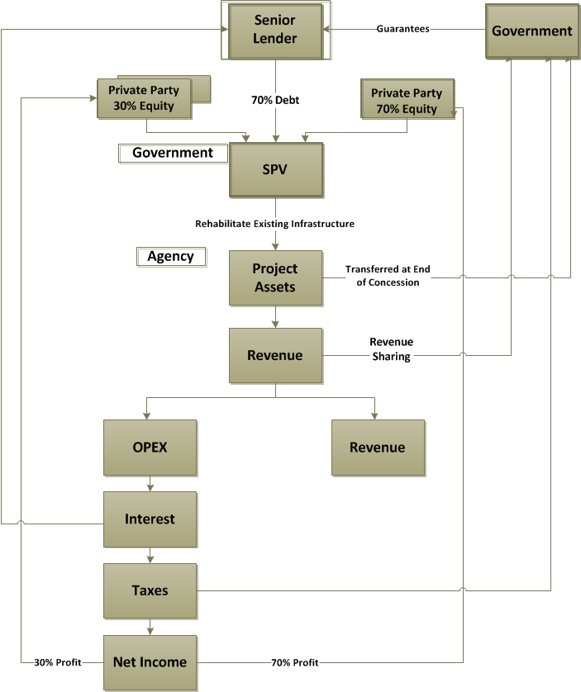
Rehabilitate operate transfer (rot)
Application: Retrofit Sewage and Water System

Slide 30
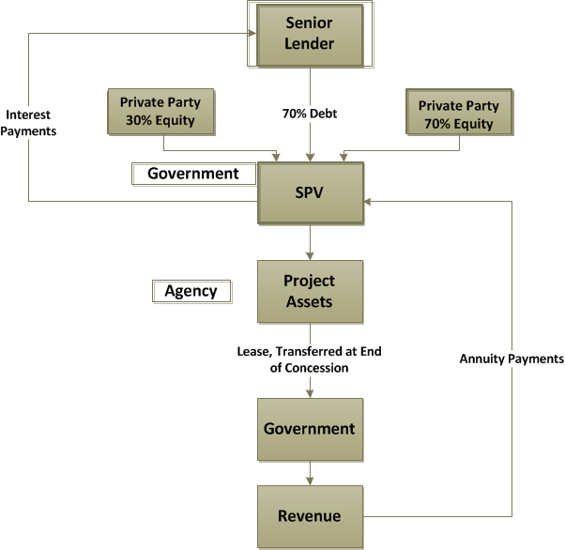
Build lease transfer (blt)
Application: Power Plant, Utilities Sector, Port Terminals

Slide 31
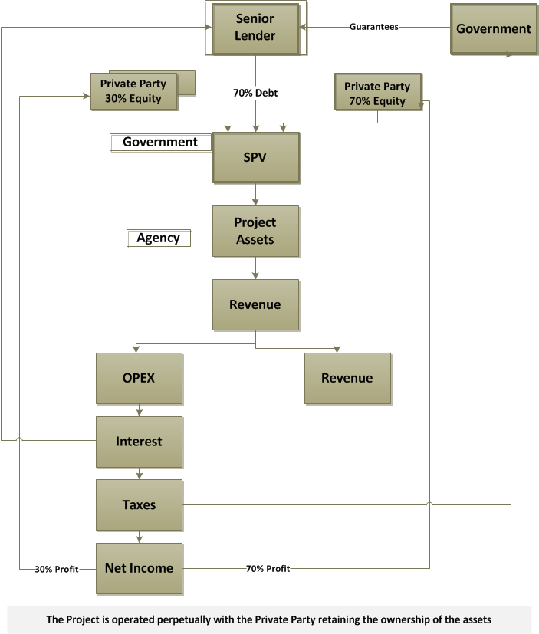
Build own operate (boo)
Application: Telecommunication, Power Plant, Waste Water System

Slide 32
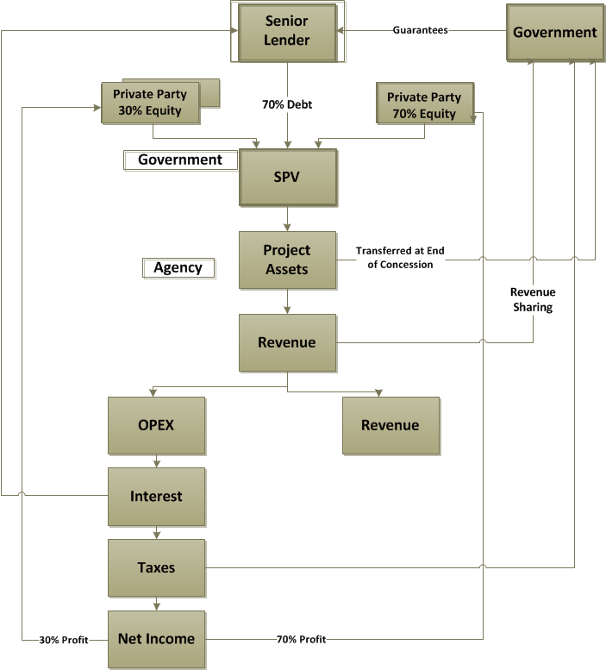
Build operate transfer (bot)
Application: Develop highway networks, Power Plants, Utilities, Airports & Bus Terminals

Slide 33
Ipdf – select projects

Slide 34
Ipdf – select ppp projects
Fuel Farm at New Benazir Bhutto International Airport Project
Line Ministry
Civil Aviation Authority
Project Cost
USD 25 Million
Concession Period
30 Years
Project Modality
Project Scope
Financials
Current Status
Build, Own, Operate, Transfer (BOOT)
Private operator will build fuel farms for storage and dispensing of aviation fuel and petrochemical products at the new BBIA as well as Operate and Maintain (O&M) the Hydrant Refueling System (HRS).
The contract is set to be awarded to Pakistan State Oil (PSO)
Internal Rate of Return (IRR) - 22%
Project Net Present Value NPV) – USD. 235 million
Payback period – 5-6 years

Slide 35
Ipdf – select ppp projects
Pakistan Railway Track Access Project
Line Ministry
Pakistan Railway
Project Cost
USD 327 Million
Concession Period
20 Years
Project Modality
Project Scope
Financials
Current Status
Finance, Own, Operate (FOO)
Private operator(s) to operate freight and passenger trains on the Track of Pakistan Railways and pay the relevant Track Access Charge to Pakistan Railways for utilizing its infrastructure.
3 Parties have submitted their bids for evaluation. Letter of Support to be issued
Internal Rate of Return (IRR) - 22%
Project Net Present Value NPV) – USD. 235 million
Payback period – 5-6 years

Slide 36
Questions & answers

